Slide 1
Programming of smart device components
Asistentas : Simonas Česnauskas

Slide 2
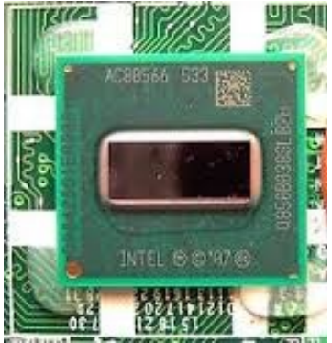
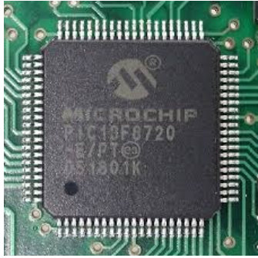
Microprocessors and microcontrollers

Slide 3
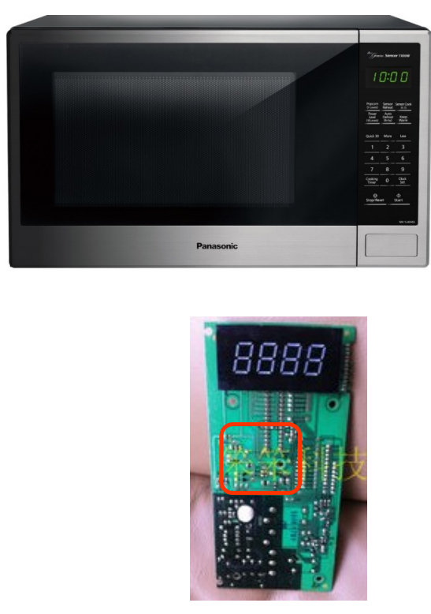
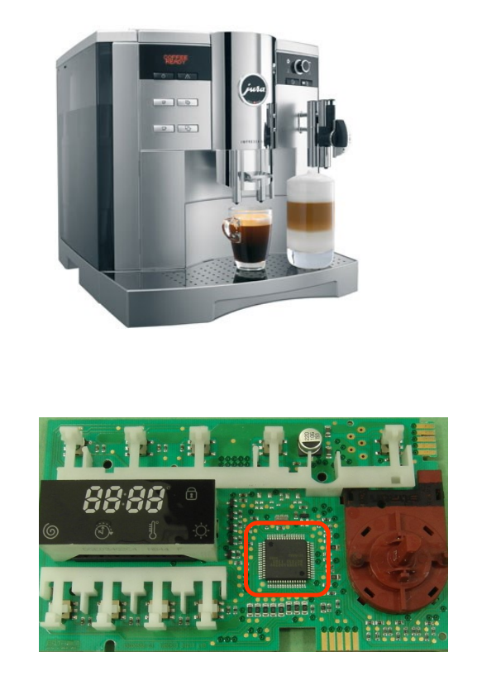
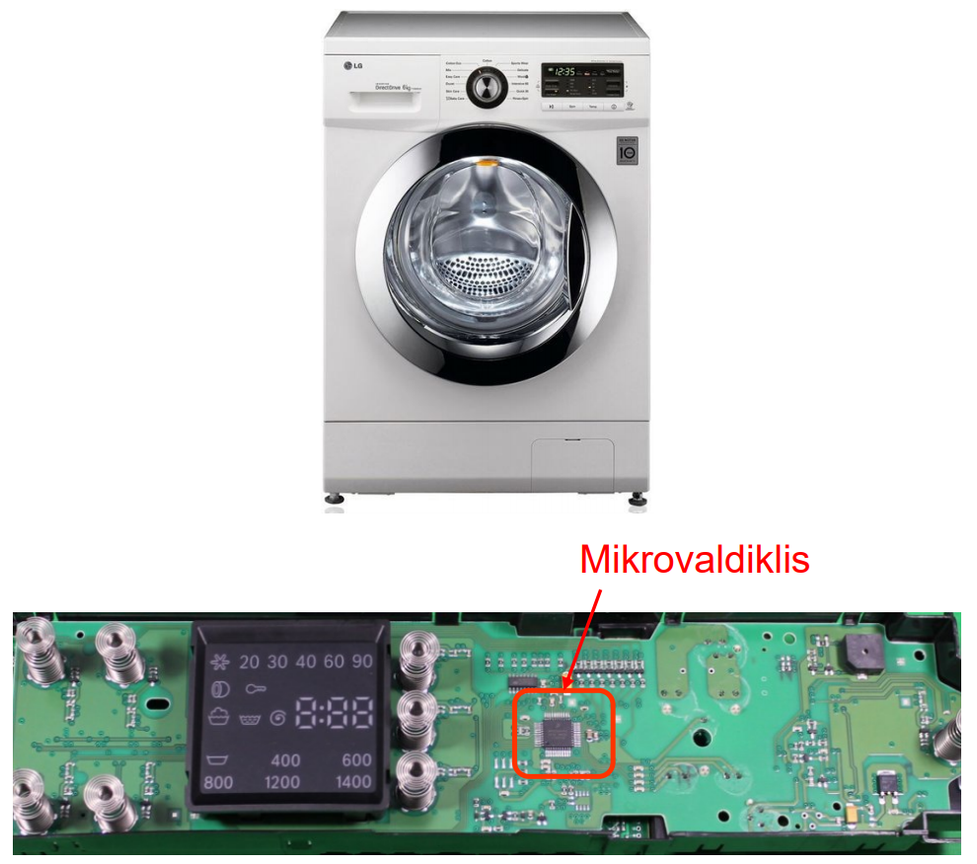
Household microprocessor devices

Slide 4
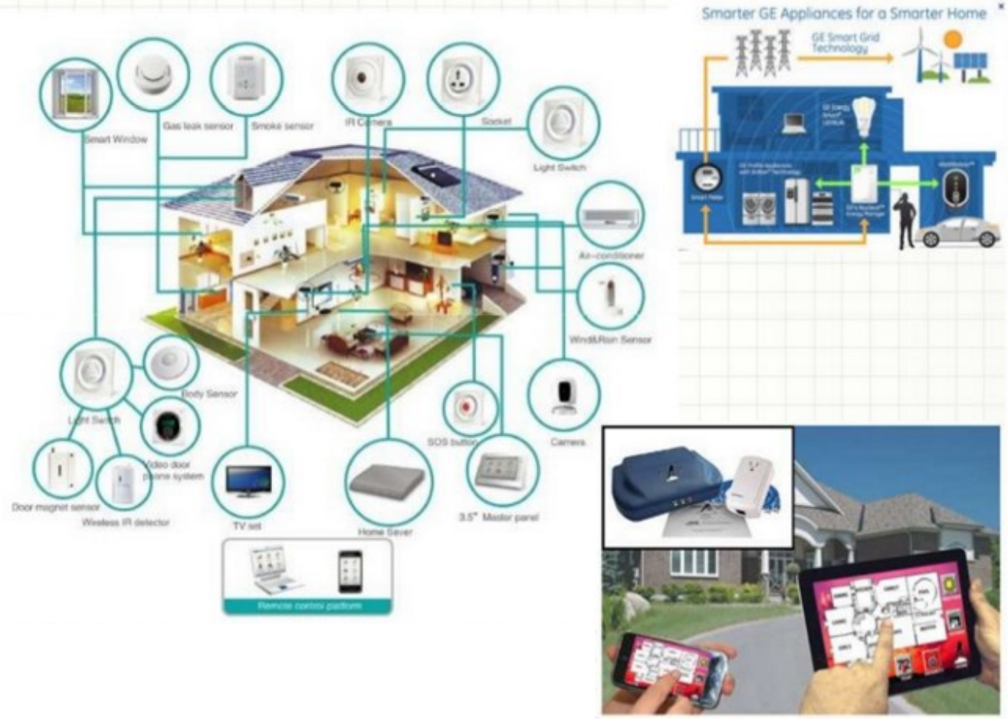
Smart home system

Slide 5
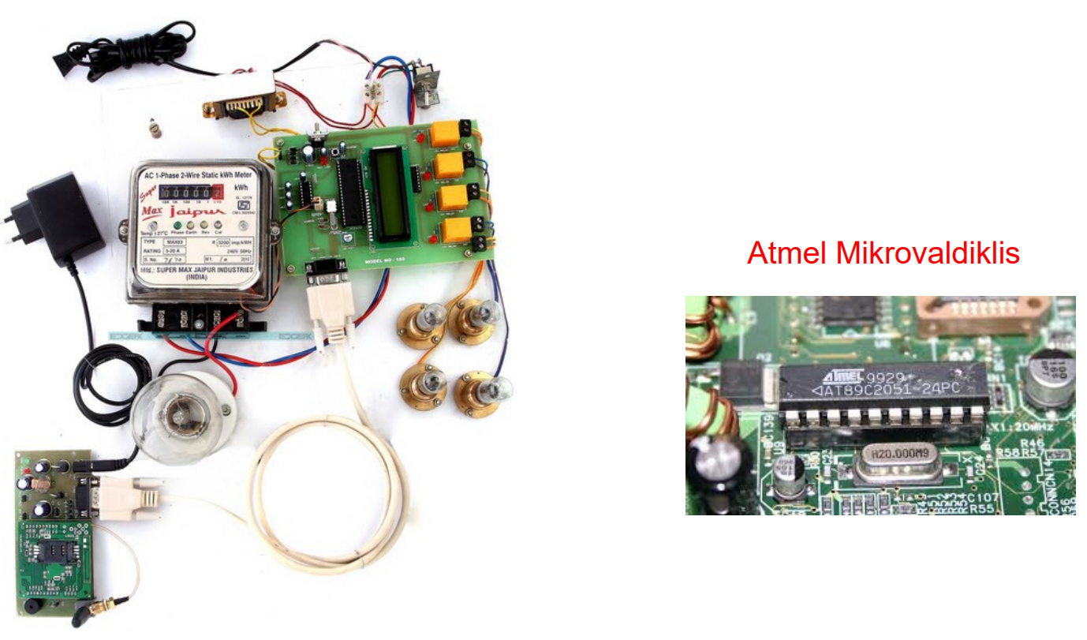
Microprocessors in electrical engineering and electronics

Slide 6
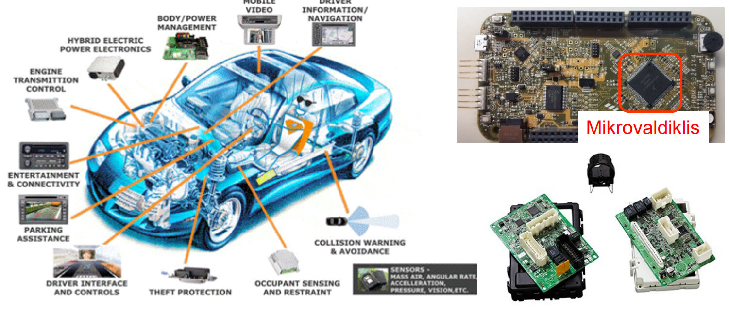
Microprocessors in cars

Slide 7
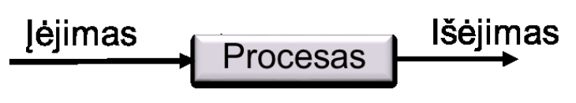
Microprocessor system
The word system is used to describe any organization or device with three characteristics :
the system must have at least one input,
at least one output,
and must perform some function of it.
A real system has more than one input or output. Like all other systems, a microprocessor system has: inputs, outputs and performs certain functions.

Slide 8
Basic concepts
Microprocessor, a device performing arithmetic, logic and control operations implemented in one integrated chip (microcircuit).
RAM - Random Access Memory - A random access memory.
ROM (Read Only Memory) - Read only memory.
PROM - (Programmable Read-Only Memory) - programmable memory.
EEPROM - Electrically Erasable Programmable Read-Only Memory - Electrically Erasable Programmable Read-Only Memory.

Slide 9
Basic concepts
Microcontroller - An integrated circuit containing the microprocessor, memory and other modules necessary for the operation of the microprocessor and for communication with external devices.
Controller - a functionally completed self-acting device performing certain predefined control functions.

Slide 10
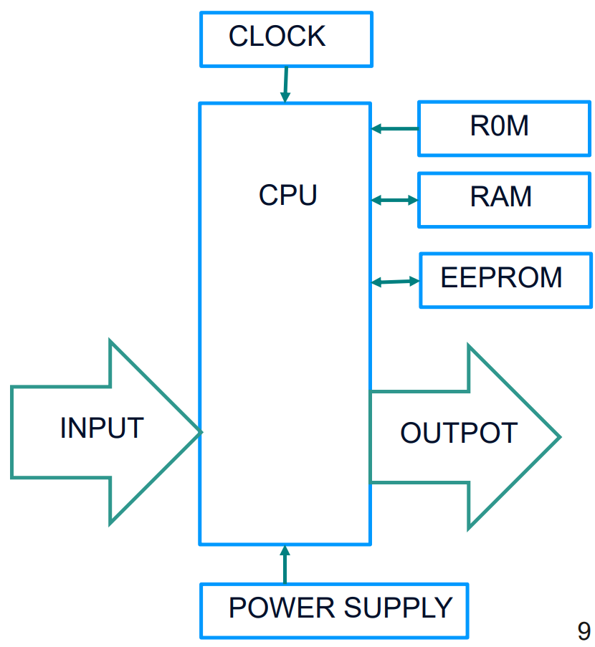
Microprocessor system components
Microprocessor System MPS (Microprocessor System) is a functionally complete system consisting of :
Central Processing Unit (CPU),
Input ports,
Output ports,
Tactical Pulse Generator (Clock)
Power Supply
Memory required for data storage: ROM, RAM, EEPROM

Slide 11
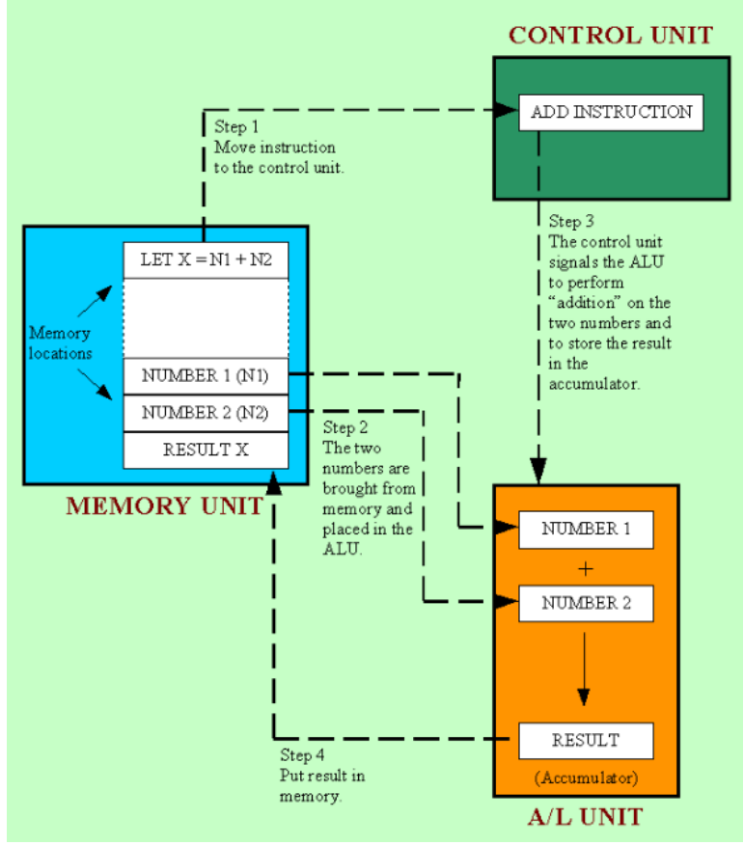
Principle of microprocessor operation
Four steps to CPU operation :
The Control Unit receives the instruction from the Memoary and decrypts the instruction
The control unit takes the required data from the memory and transfers it to the Arithmetic Logic Unit (ALU).
ALU handles data;
ALU returns the result to memory (Registers).

Slide 12
Processor architectures
There are two main architectures of modern processors. CISC, and RISC. RISC - (Reduced Instruction Set Computer) - a computer with a small and optimized set of instructions that are adapted to perform sequences of actions;
CISC - (Complex Instruction Set Computer) - a computer with a large number of (almost all possible actions) instructions, the selection and execution of which is much more difficult than in RISC computers;
Examples of CISC processor architectures: Intel x86 (personal computers), Motorola 68k (embedded systems), IBM z / Architecture (mainframes).

Slide 13
Processor architectures
CISC is a much older trend in processor development. The basic idea of ​​CISC is this: if we have a frequently used sequence of CPU commands, we can replace it with a special CPU instruction.
The biggest disadvantage of CISC processors is the very wide set of commands. The microcode interpreter slowly processes special-purpose and rarely used commands.
RISC chips require fewer transistors to perform basic functions such as instruction decoding and logic and arithmetic operations. This allows you to increase the number of registers and add more concurrent internal device operations.

Slide 14
Processor architectures
Examples of RISC (also called load-store) processor architectures: ARM (smartphones and microcomputers), AtmelAVR (microcontrollers), Microship PIC (microcontrollers), Texas Instruments MSP (microcontrollers).

Slide 15
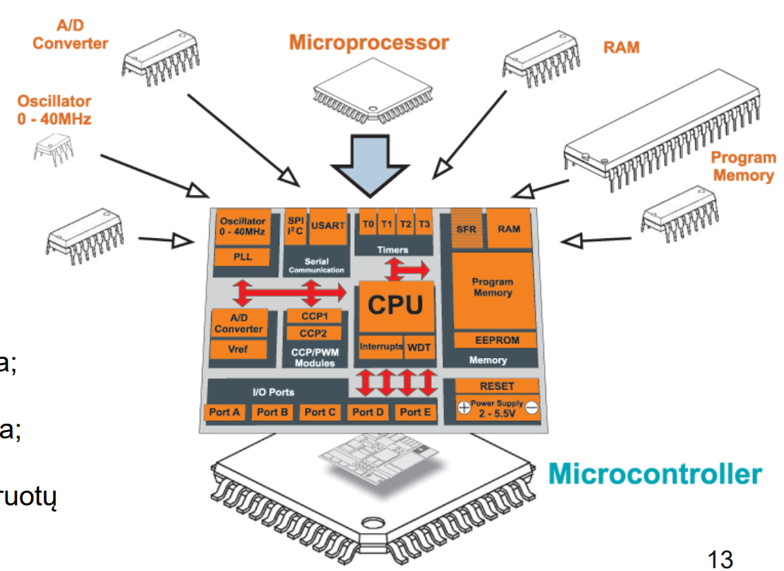
Microcontroller concept
the idea of ​​a microcontroller: to accommodate as many electronic circuits as possible in one chip, so that the final design of the device requires as few additional elements as possible;

Slide 16
Microcontroller features
Computer on a single chip, embedded in an electronic board;
Runs only one program (usually stored in internal Flash memory);
Relatively low electricity consumption;
Relatively cheap;
Works in a wide range of temperatures;
Relatively slow;

Slide 17
Data format
Computers work with binary data. Log1 - there is a signal Log0 - there is no signal.
The microprocessor does not handle data but variables. The variable has two values: address and value, which are expressed in binary (a code consisting of 0 and 1), machine code. E.g. 1000110
The smallest unit of measurement for data is the bit, which is 0 or 1.
The byte is 8 bits. T.y. from 00000000 to 11111111, calculated from 0 to 7. Other units of measurement of data and information are derivatives:

Slide 18
Microcontroller bus width
Microcontrollers are classified by bus width :
8-bit microcontrollers;
16-bit microcontrollers;
32-bit microcontrollers

Slide 19
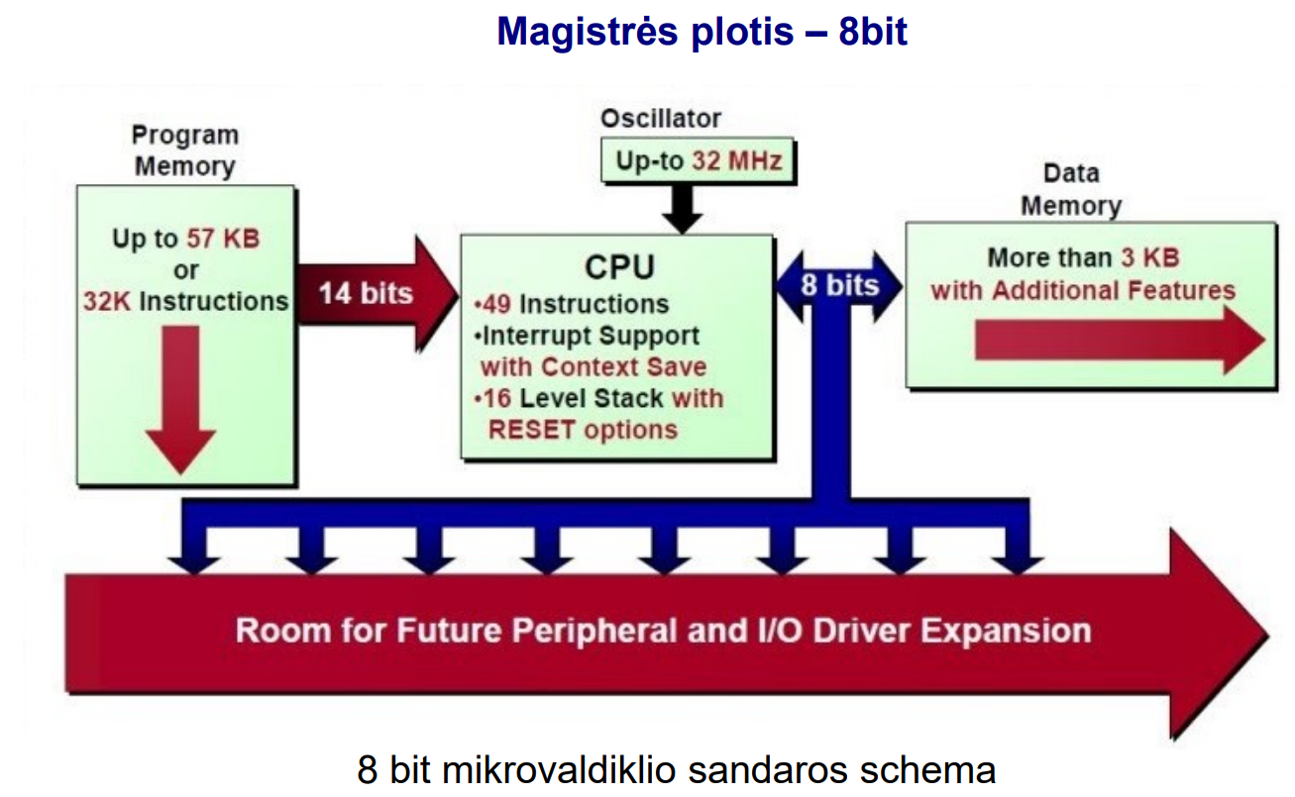
Microprocessor and microcontroller
The microcontroller's class by bits indicates the width of its bus with memory and external devices

Slide 20
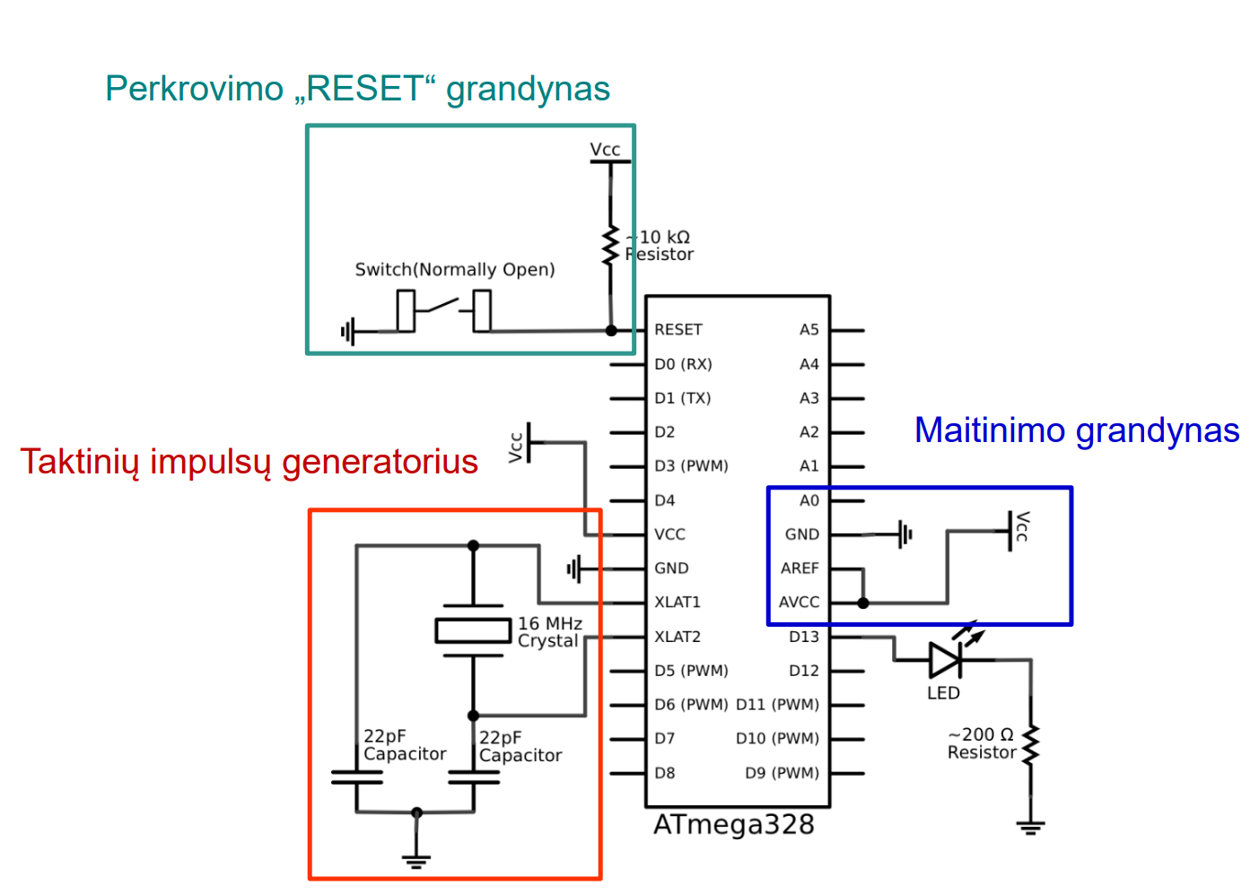
Minimum microcontroller circuit diagram

Slide 21
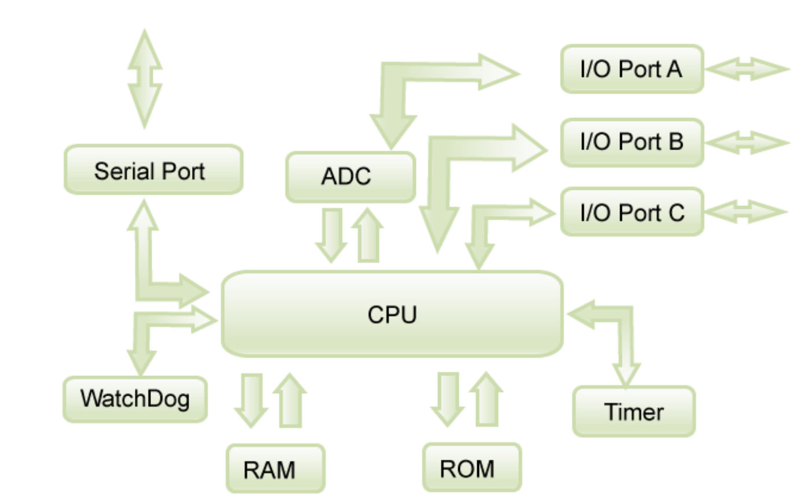
Generalized microcontroller architecture

Slide 22
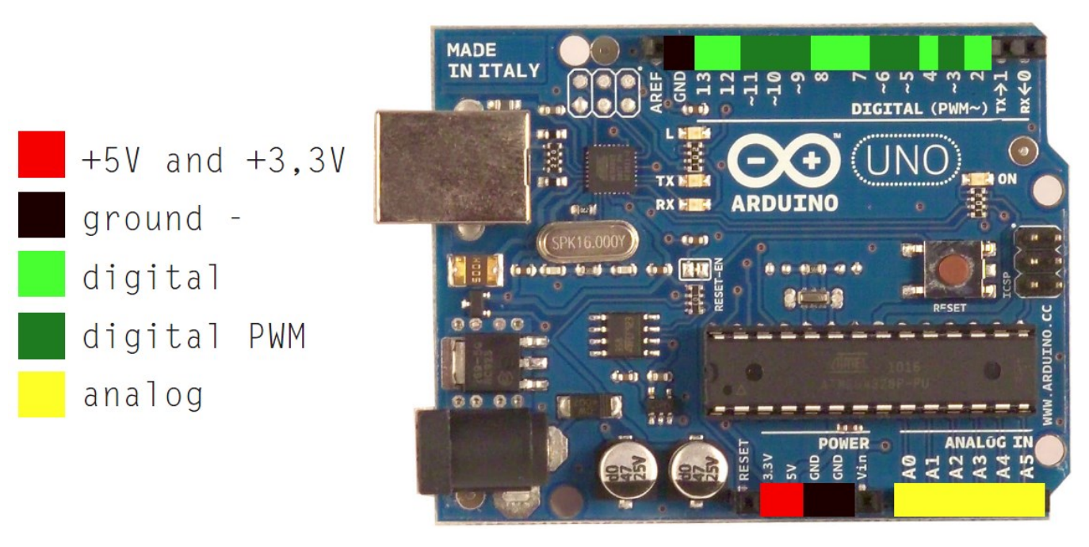
Arduino UNO controller

Slide 23
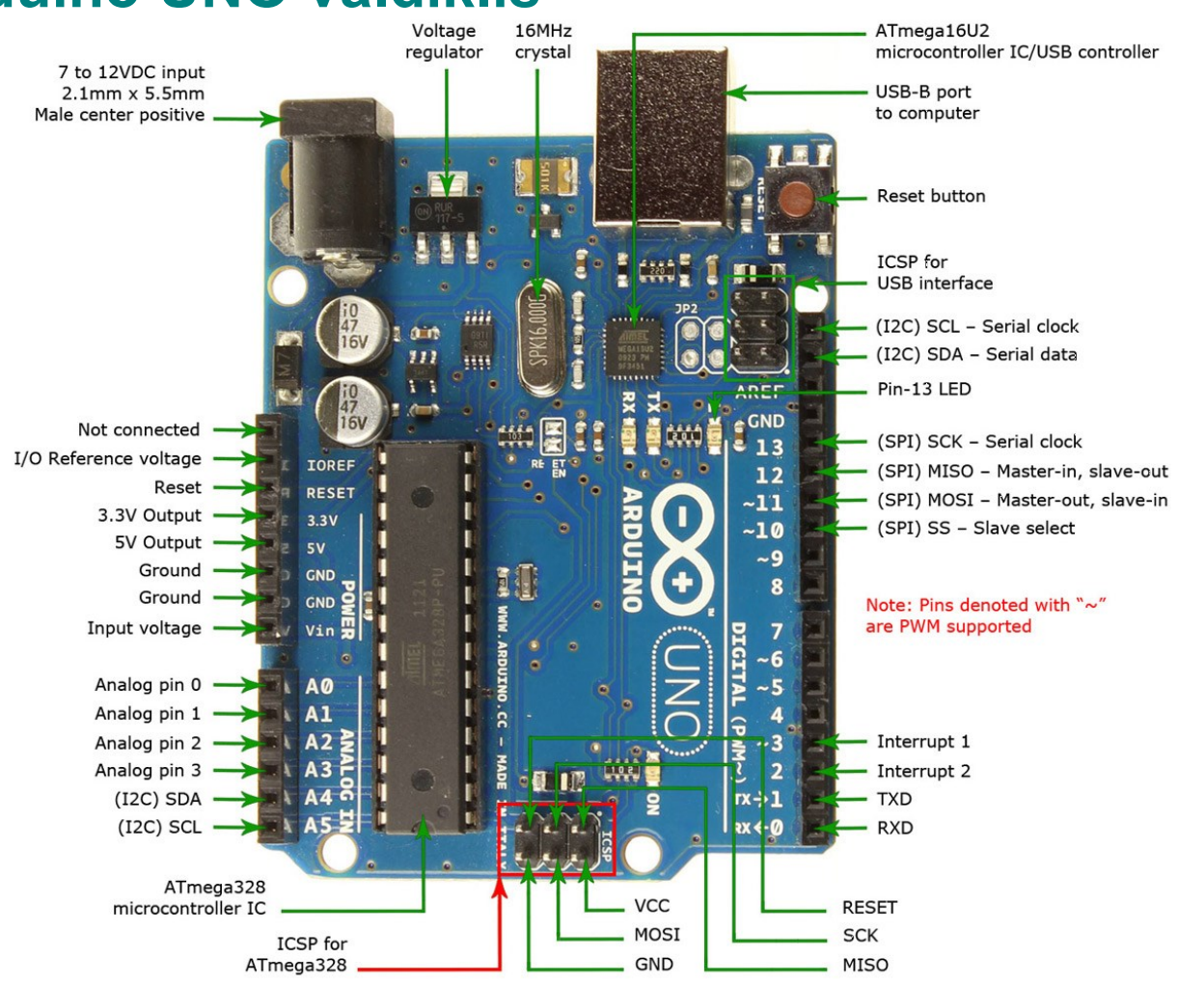
Arduino UNO controller

Slide 24
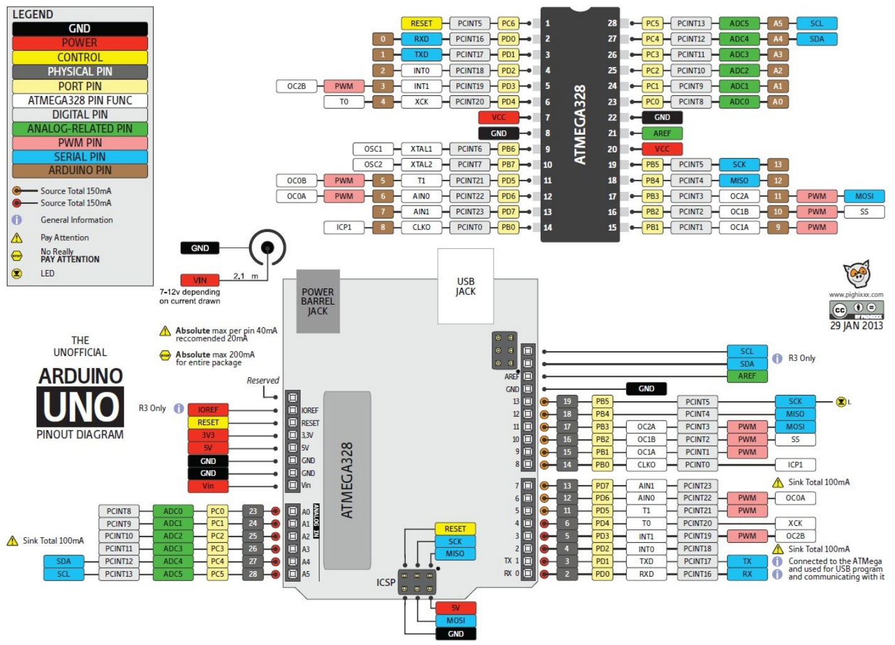
Arduino UNO controller

Slide 25
Next - Arduino programming

Slide 26
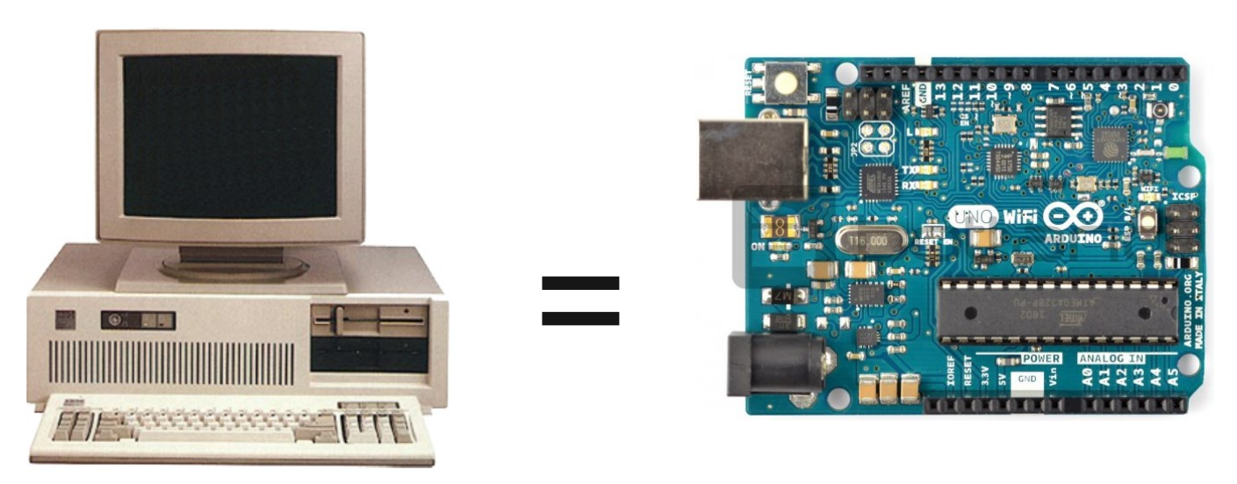
Arduino controller

Slide 27
Programming language, language types and generations
A programming language is a language used to write programs for a computer that would allow the use of computer resources for certain calculations or algorithms. The following generations of programming languages ​​can be distinguished:
Machine Code Language (0's and 1's).
Assembly variants (symbolic code abbreviations).
Algorithmic languages ​​(FORTRAN, Pascal, C, C ++, etc.).
Non - procedural languages ​​(Maple, MatLab, database languages, etc.).
Natural language (so far the goal).

Slide 28
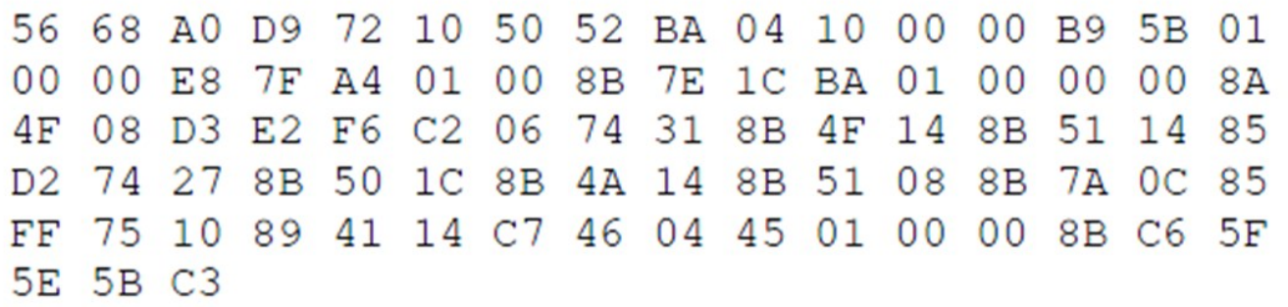
Machine language
The first calculating machines did not have programming languages ​​and were programmed with machine codes, such a code. example :
Problem :
Numerous computing machines with different machine languages ​​were developed. Therefore, the programmer had to learn the command system of a specific computing machine. In addition, language incompatibilities have prevented the development of universal, multi-machine applications.

Slide 29
Assembly language
A low-level programming language for marking machine commands for computers of a certain architecture. Words are already used in this language, which are usually abbreviations for English words.

Slide 30
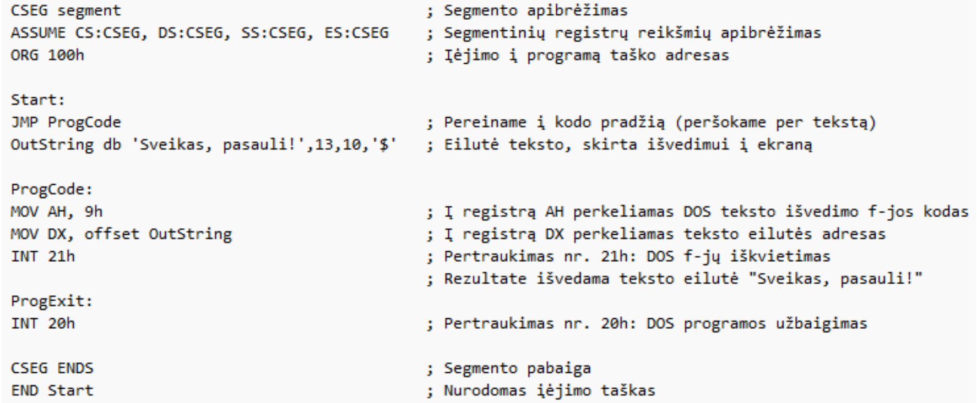
Assembly language
Intel 8086, DOS syntax e.g. The program is a healthy world :

Slide 31
C, C ++ programming languages
The C programming language is a relatively low-level programming language, originally intended for use on the UNIX operating system.
The C language is widely used for the development of operating systems, compilers, and other system applications, as well as for the programming of hardware with microcontrollers and microprocessors. E.g. mobile phone, smartphone software (firmware), computer BIOS.

Slide 32
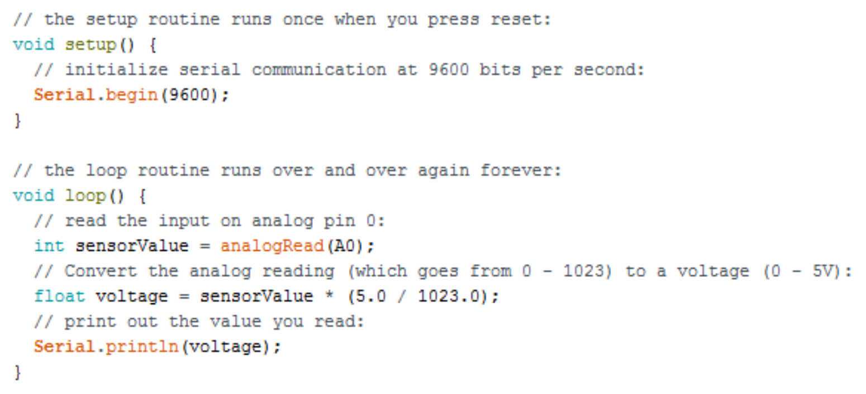
C, C ++ programming languages

Slide 33
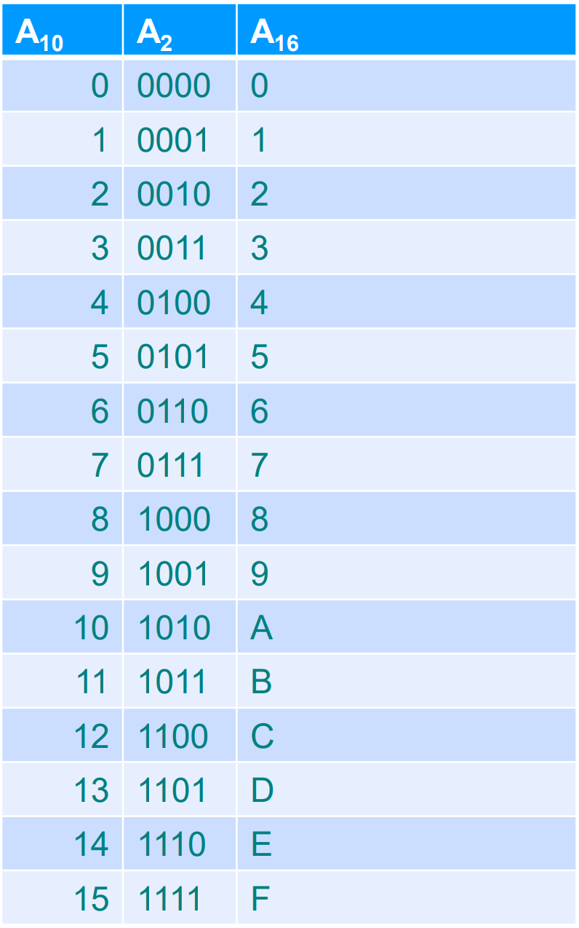
Computing systems
Decimal places - A10,
Binaries - A2,
Hexadecimal - A16
The computer counts from 0, so 0 means the first position.

Slide 34
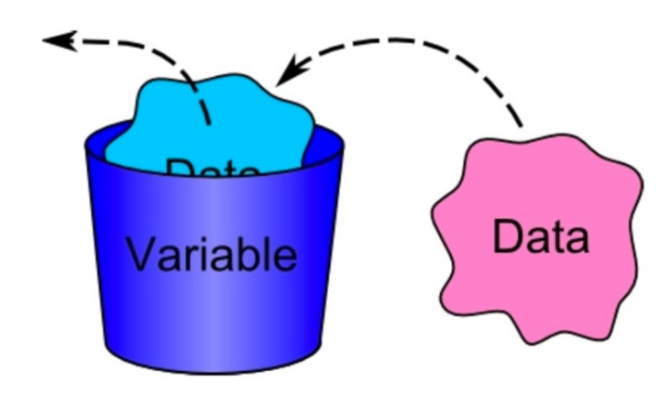
The concept of a variable
Data is stored in variables during program execution. A variable is a quantity that can change and take on different values.
In computer systems, a variable refers to a specific reserved memory location (cell). In performing operations, the CPU performs actions not on specific data but on cells.

Slide 35
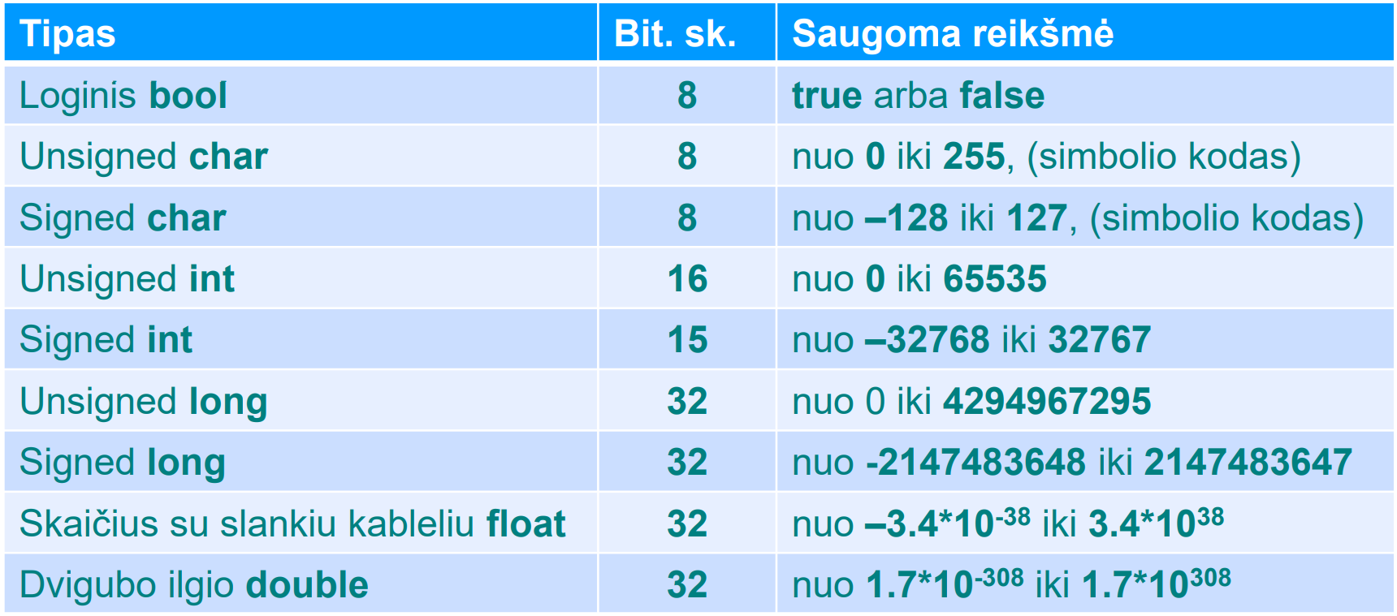
Basic data types
The data types of a variable are specified in base words that reflect the possible range of data values
Variable types and values :

Slide 36
Variable names
Each variable created must have a unique name. The name is a sequence of Latin letters, numbers, and underscores (_) beginning with a letter. No other characters are allowed in the names. Names starting with (_) are used only in the compiler as specially assigned names. To make your programs easier to understand, it is advisable to use meaningful variable names.

Slide 37
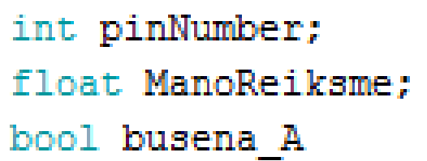
Variable names
Variable names cannot match C standard command commands setup, loop, if, for, false, case, const ...
Variable names cannot match variable types char, int, long, float, double, bool.

Slide 38
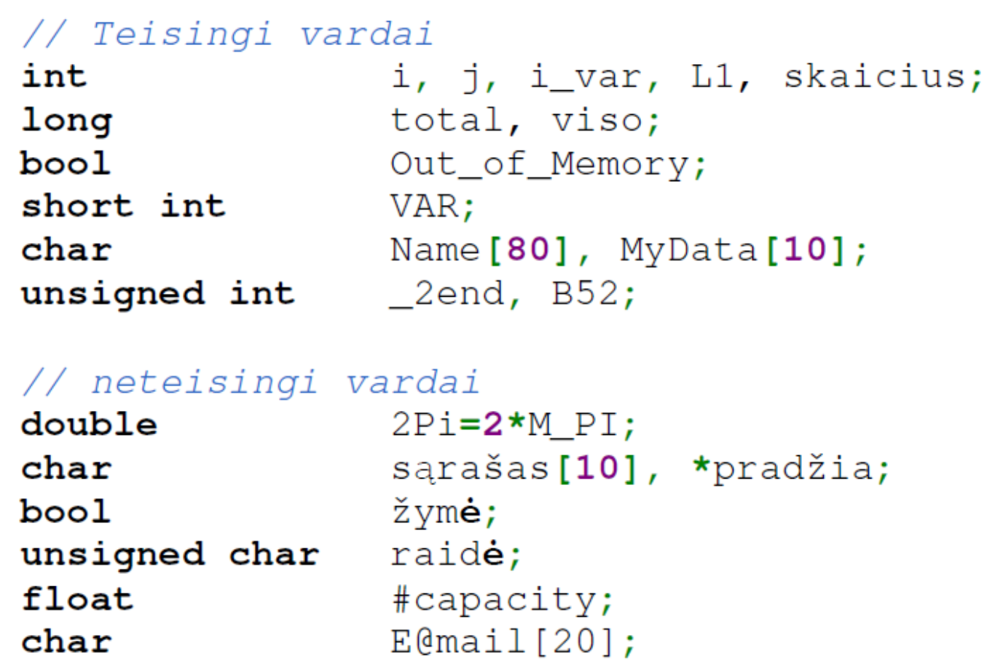
True and false names
Why are names considered incorrect?

Slide 39
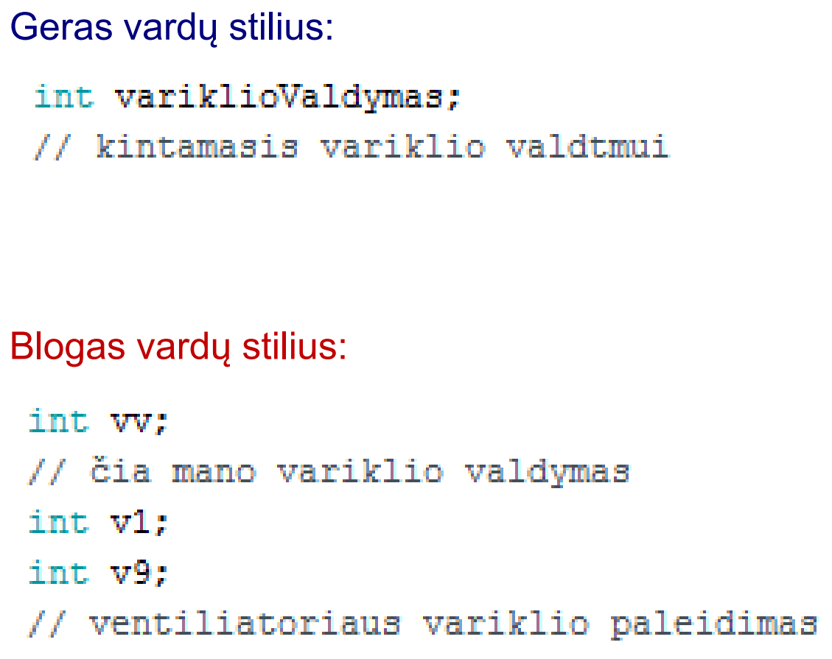
Good and bad naming style

Slide 40
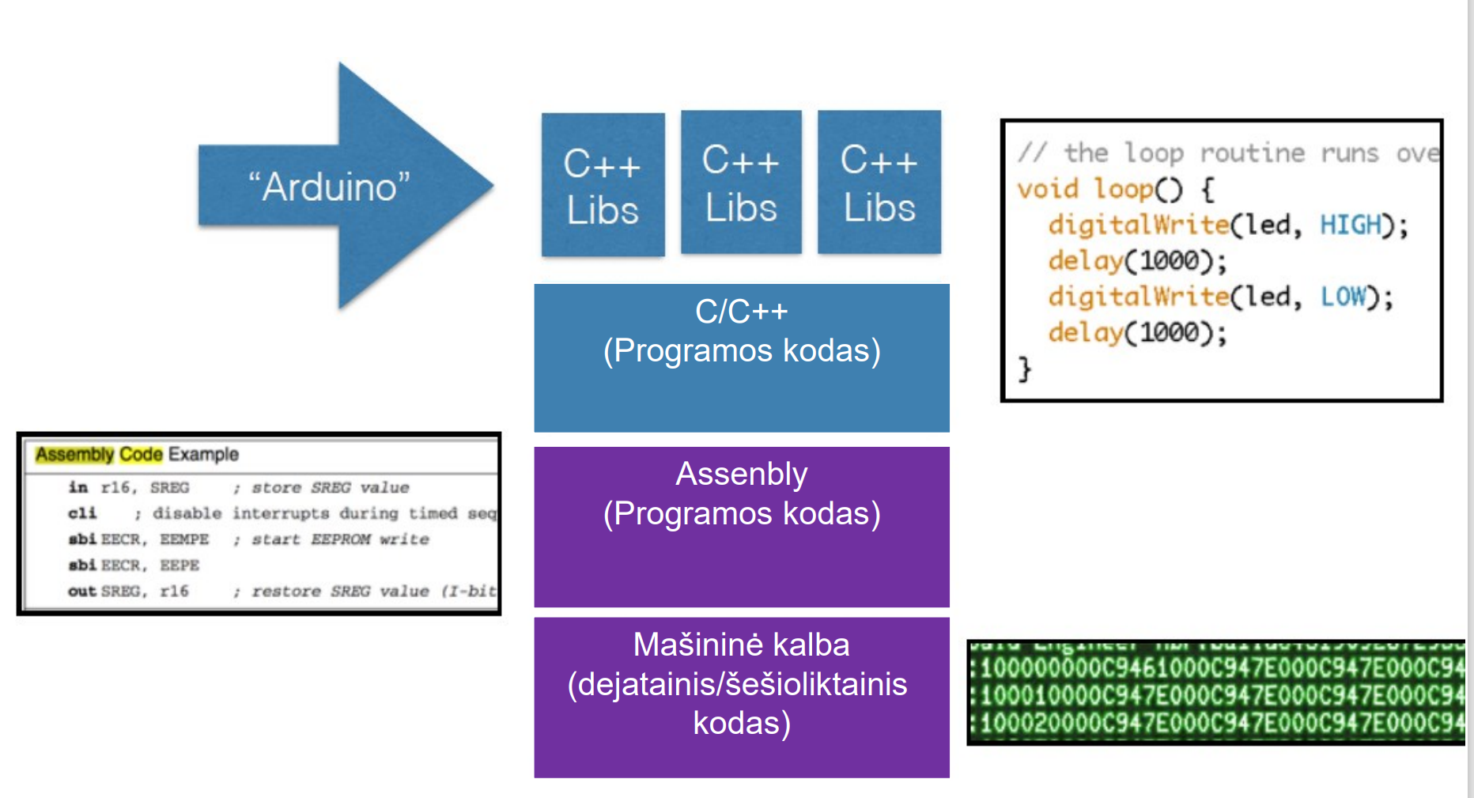
ARDUINO programming process

Slide 41
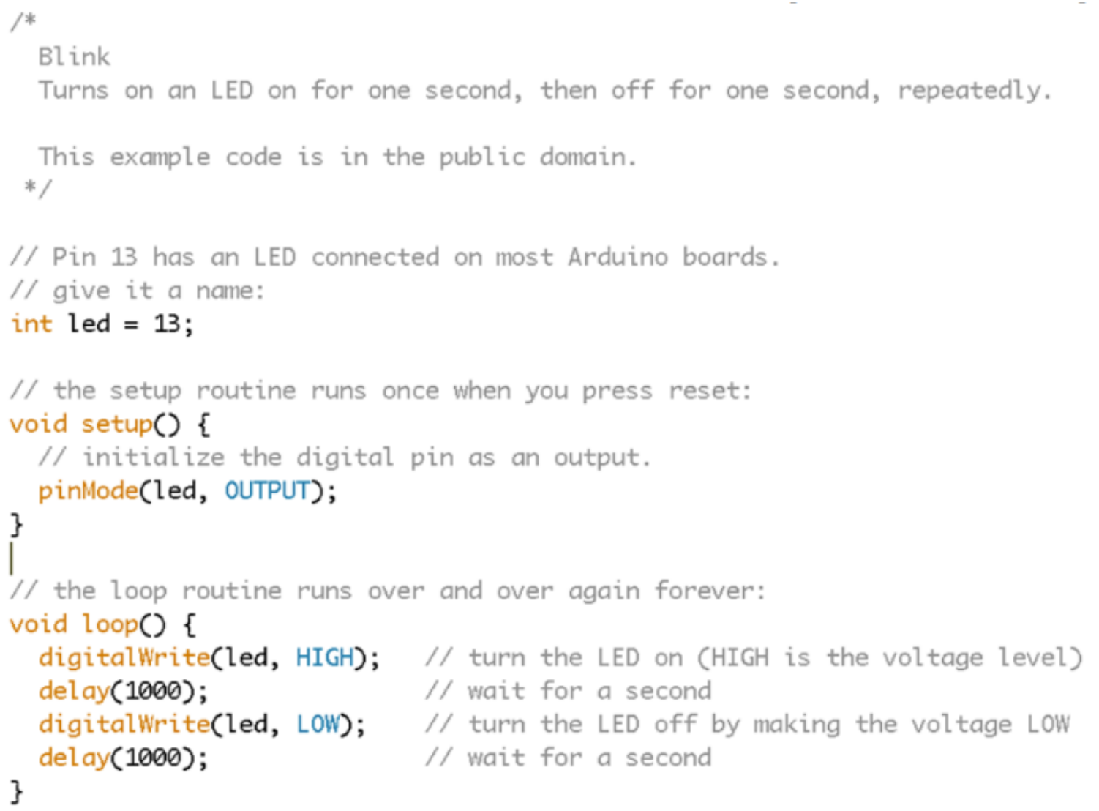
Hardware C language

Slide 42
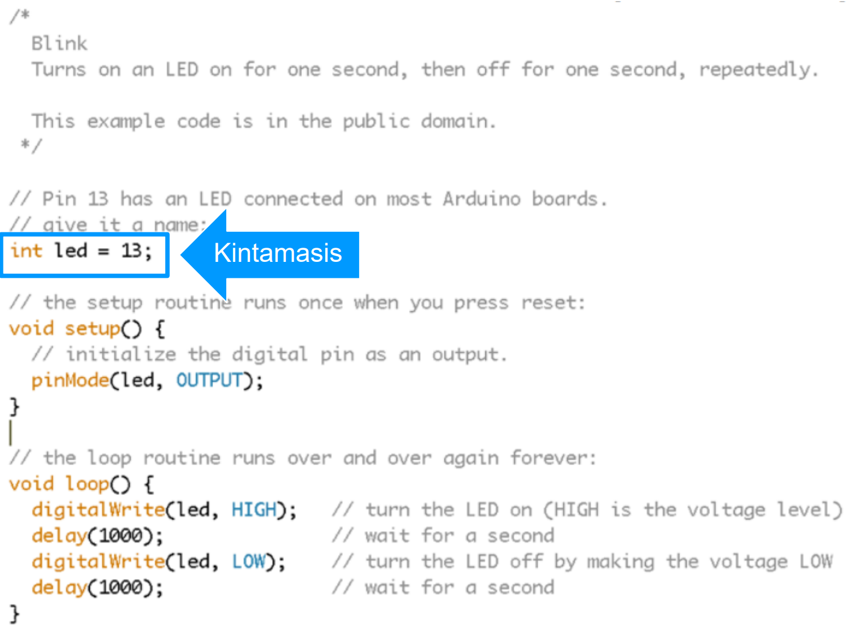
Hardware C language - variables

Slide 43

The standard expression for the variable
Standard expression of a variable :
Variable type [space] variable name attribute character initial value.
The initial value is not necessary.

Slide 44
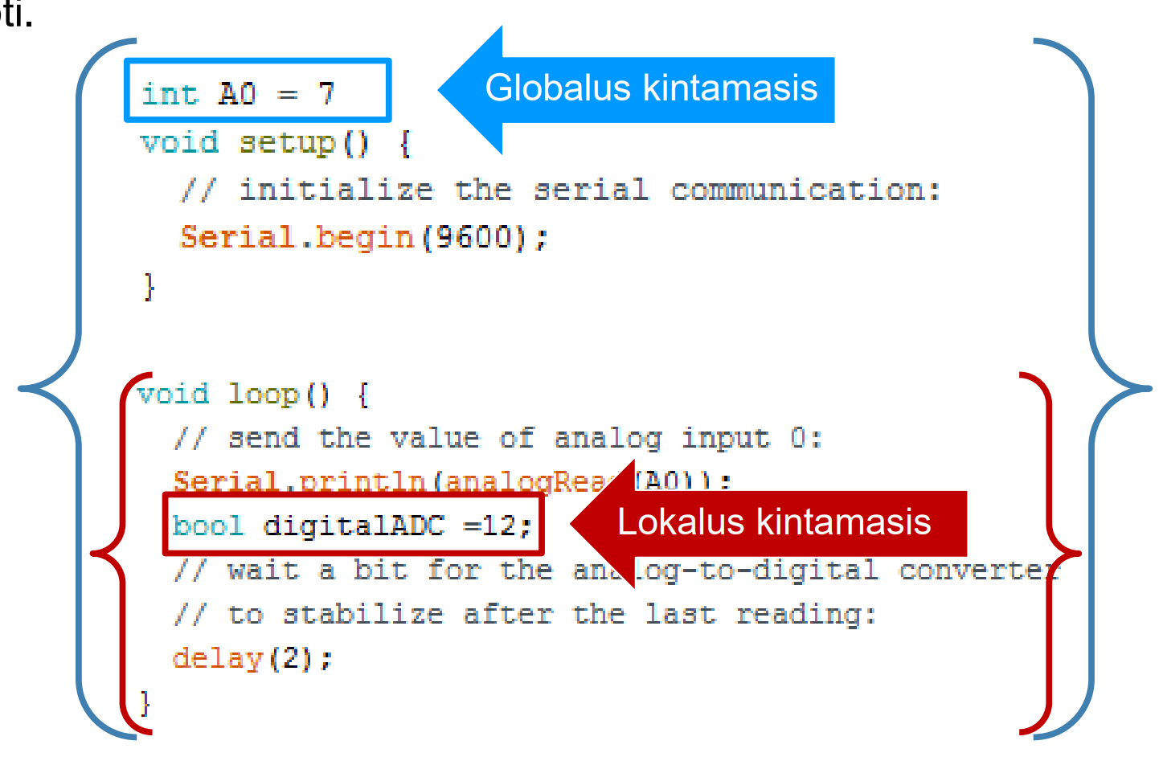
Global and local variables
Global variables are declared at the beginning of the program and are valid for the entire program code. Local variables are valid only in the function in which they are declared.

Slide 45
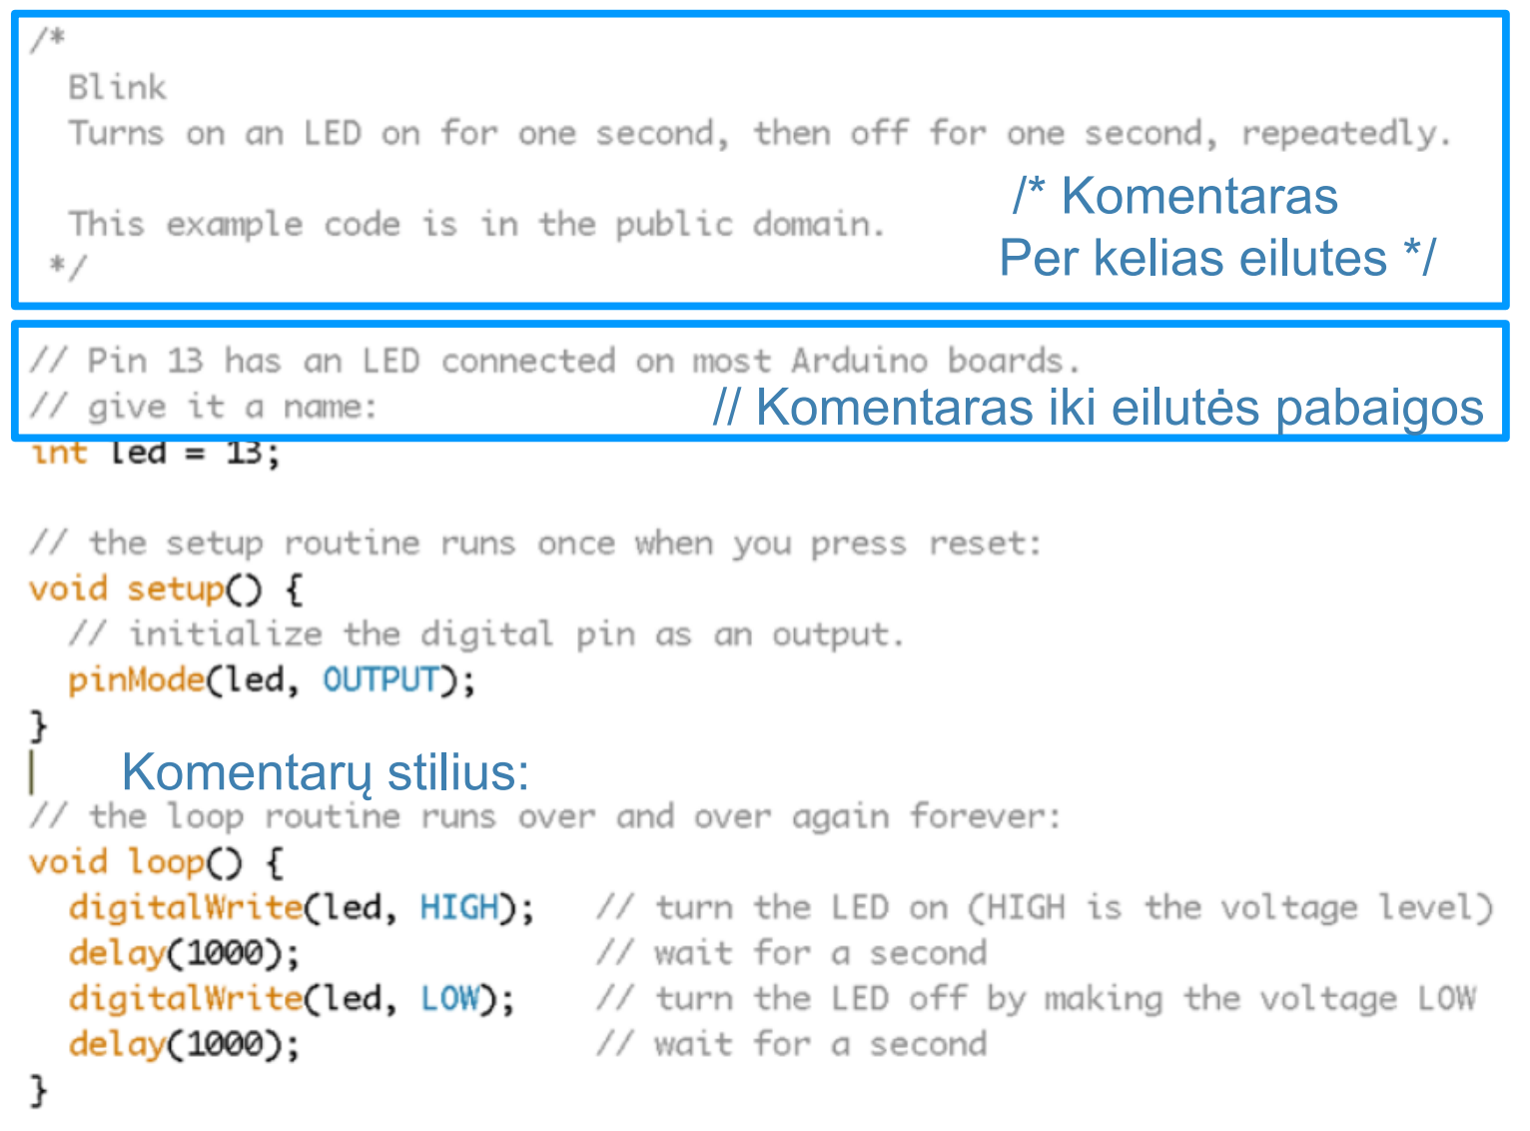
Hardware C language - comments

Slide 46

Hardware C language - comment style
Good comment:
Bad comment :

Slide 47
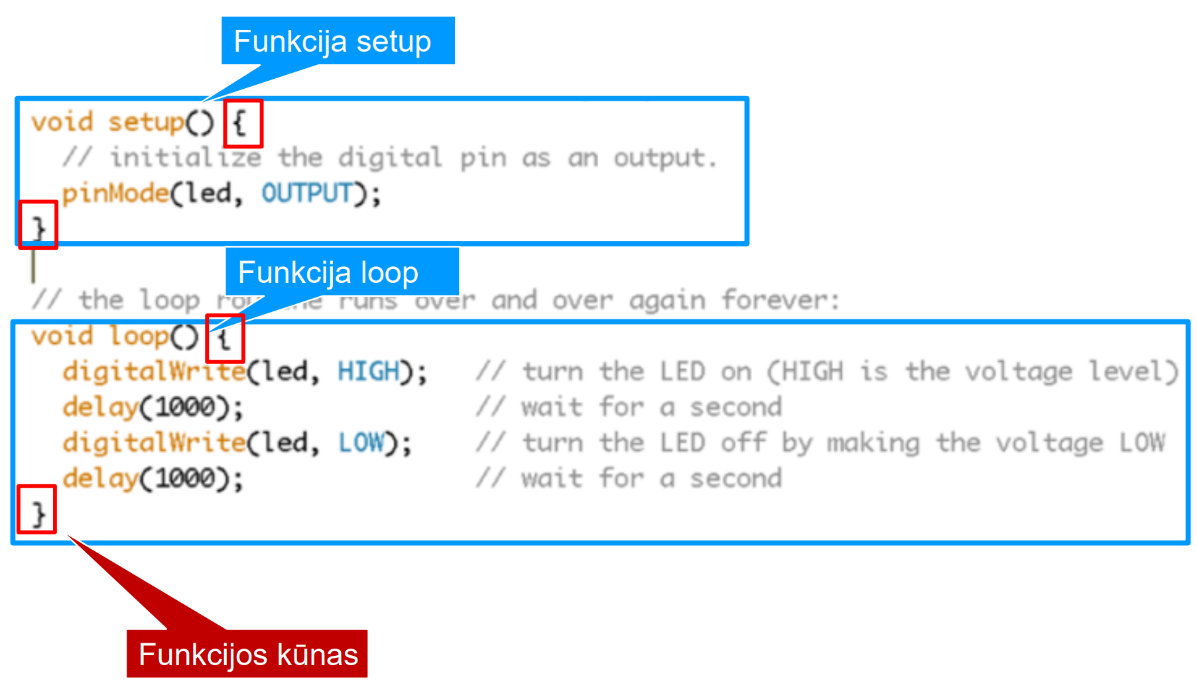
Hardware C language - features

Slide 48
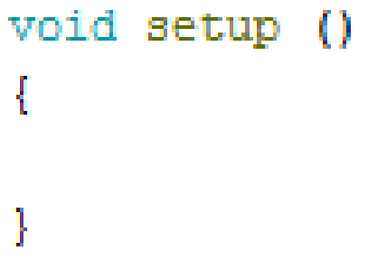
Standard expression of a function
Standard expression of a function :
Function type [space] function name [space] (argument) {function body}
The argument may be omitted

Slide 49
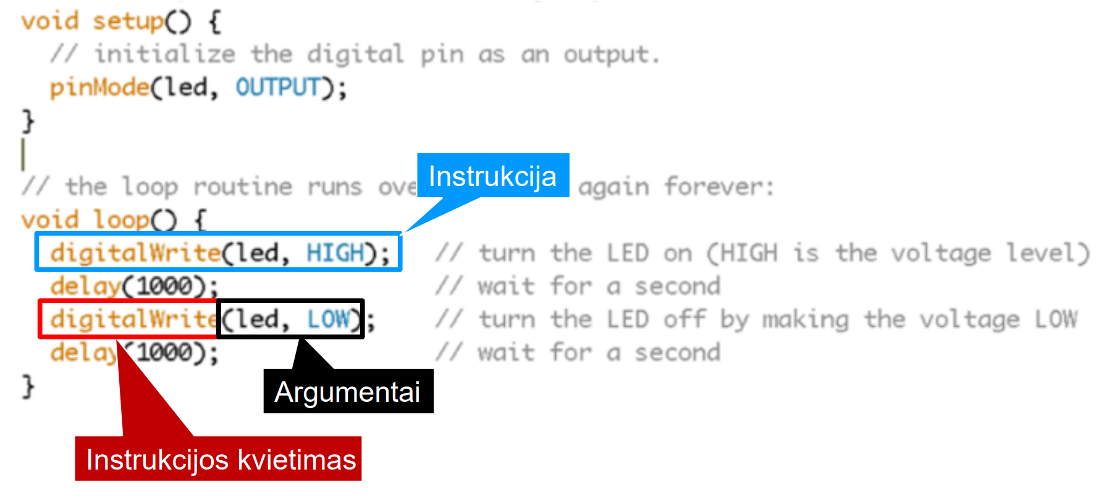
Hardware C language - instructions

Slide 50
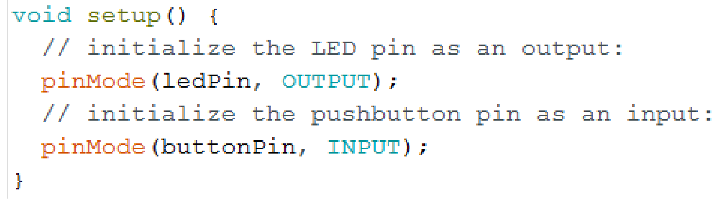
Port management

Slide 51
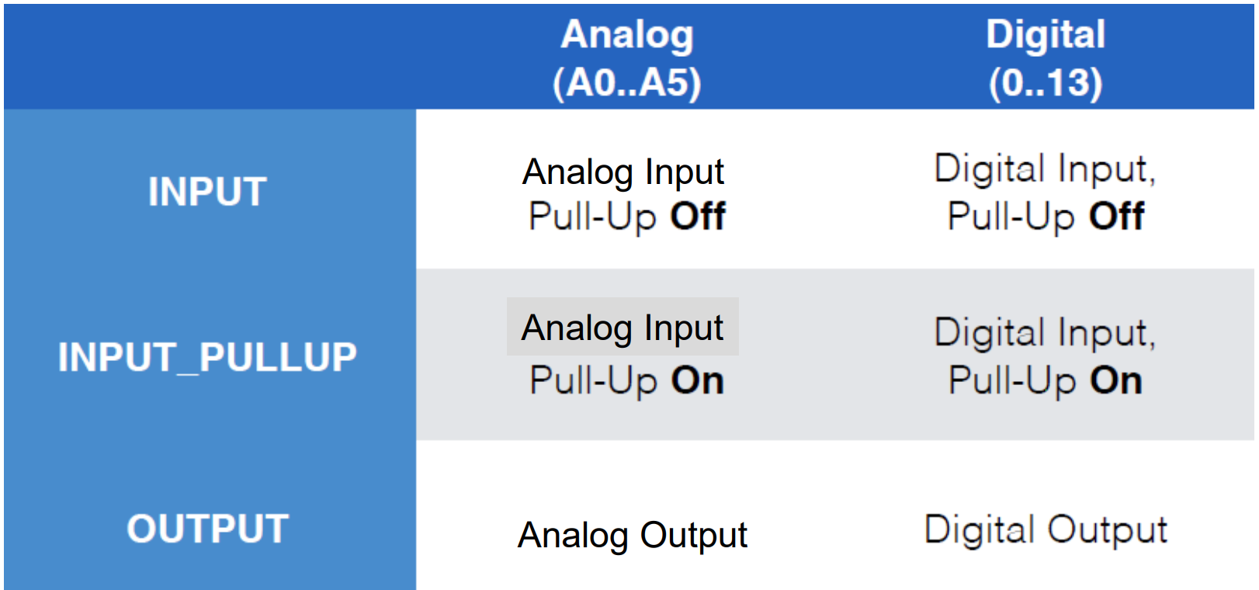
pinMode ()

Slide 52
pinMode()
Pull-Up - software connection of the balancing resistor
Analog inputs (A0 ... A5) can be used as digital, pinMode (INPUT, Ax) configuration is not necessary for analogRead ()

Slide 53
Balancing Pull-Up Resistors
Balance resistors are connected to a positive supply voltage (Pull-Up) so that the values ​​of the electrical signal at the ports are not accidental (when the "hangs in the air" input). The resistors are inside the microcontroller and are connected programmatically:
pinMode - instruction for setting the port.
() - instruction arguments :
switchPin - The first argument refers to setting the port to working mode;
, - argument separator;
INPUT_PULLUP - second argument (input with connected resistor)

Slide 54
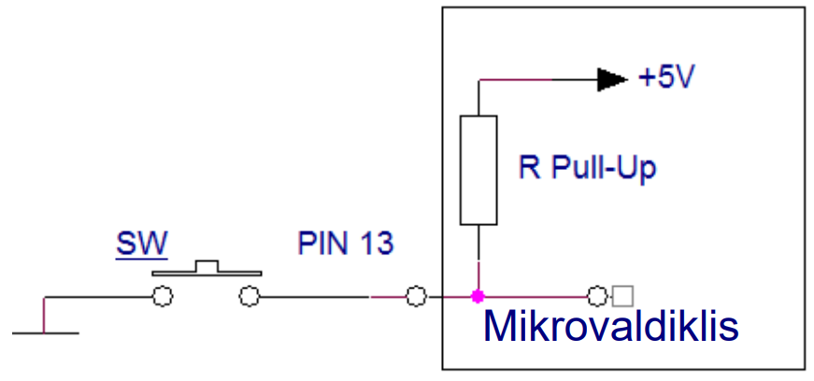
Balancing Pull-Up Resistors

Slide 55
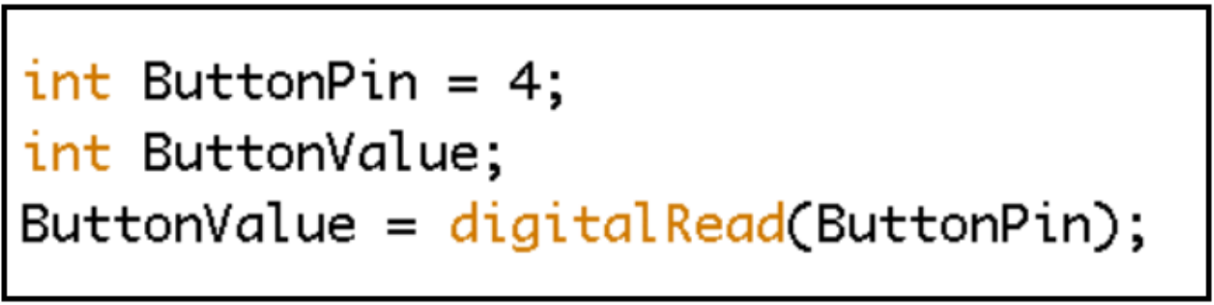
digitalRead()
Int - variable type;
ButtonPin is the name of the variable;
= - assignment operator;
4 - initial value;
; - end of line.
ButtonValue is the name of the variable;
= - assignment operator;
digitalRead () - digital scan instruction;
() - instruction arguments - ButtonPin variable.

Slide 56
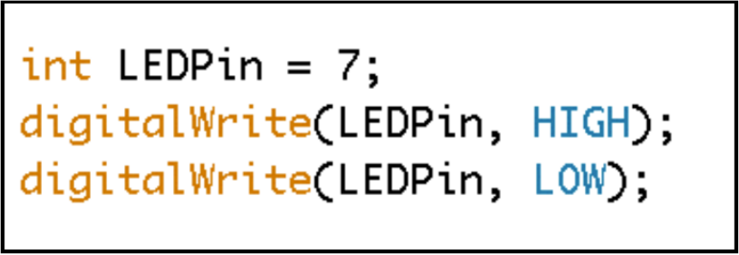
digitalWrite()
Int - variable type;
LEDPin is the name of the variable;
= - assignment operator;
7 - initial value;
; - end of line;
digitalWrite () - digital recording instruction;
() - function arguments :
LEDPin is the first argument;
, - argument separator;
HIGH is the second argument.

